Slide 1

Evolving a 4-species bacterial community – A genomics perspective
Collaboration with Prof. Sara Mitri, UNIL
Evolutionary ecology of microbial communities Lab

Slide 2
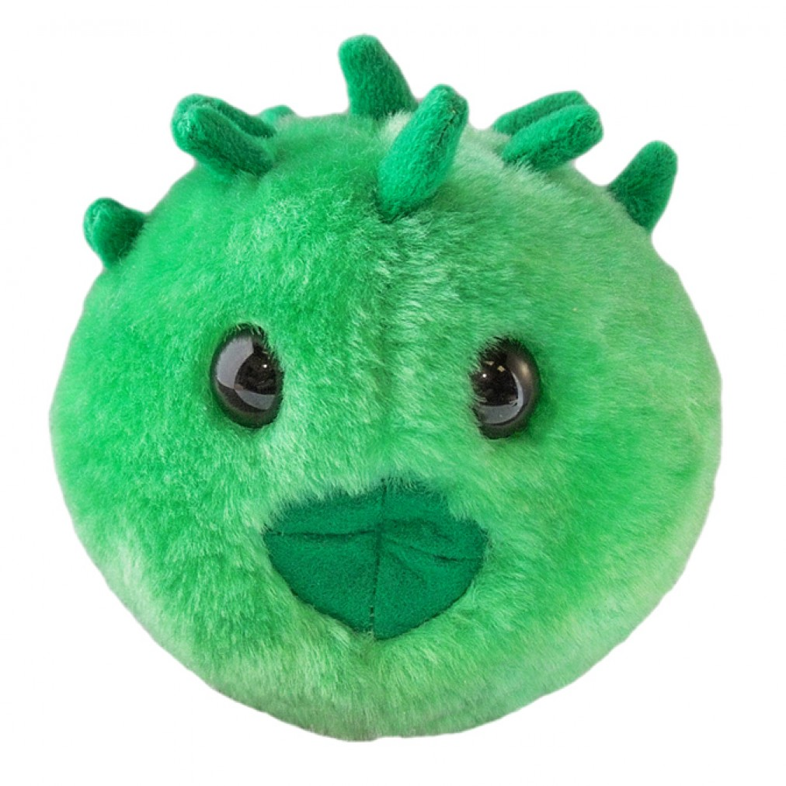
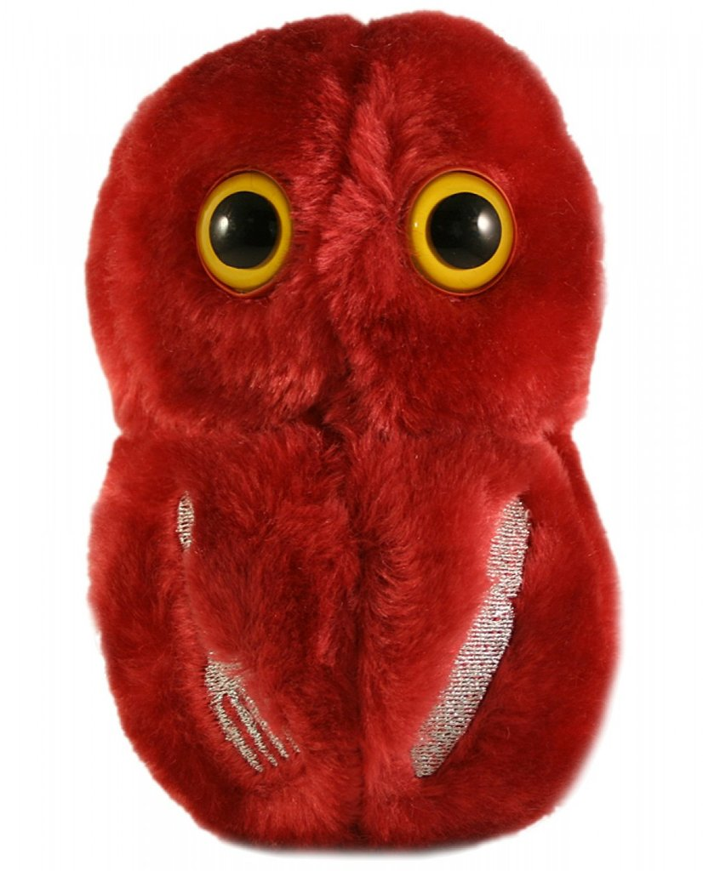
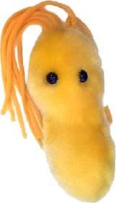
Sara’s lab goals are
to predict community co-evolution and
to control evolving communities
?
?
?
Notes:
We want to find general principles or rules of thumb that will help us to predict…

Slide 3
Why this presentation ?
Currently, I am trying to understand the (sequencing) data we have
Some very basic descriptive plots to “understand” the data
How can we use this to answer meaningful evolutionary questions ?
What I would like to hear from you: suggestions about meaningful questions (end of presentation)

Slide 4
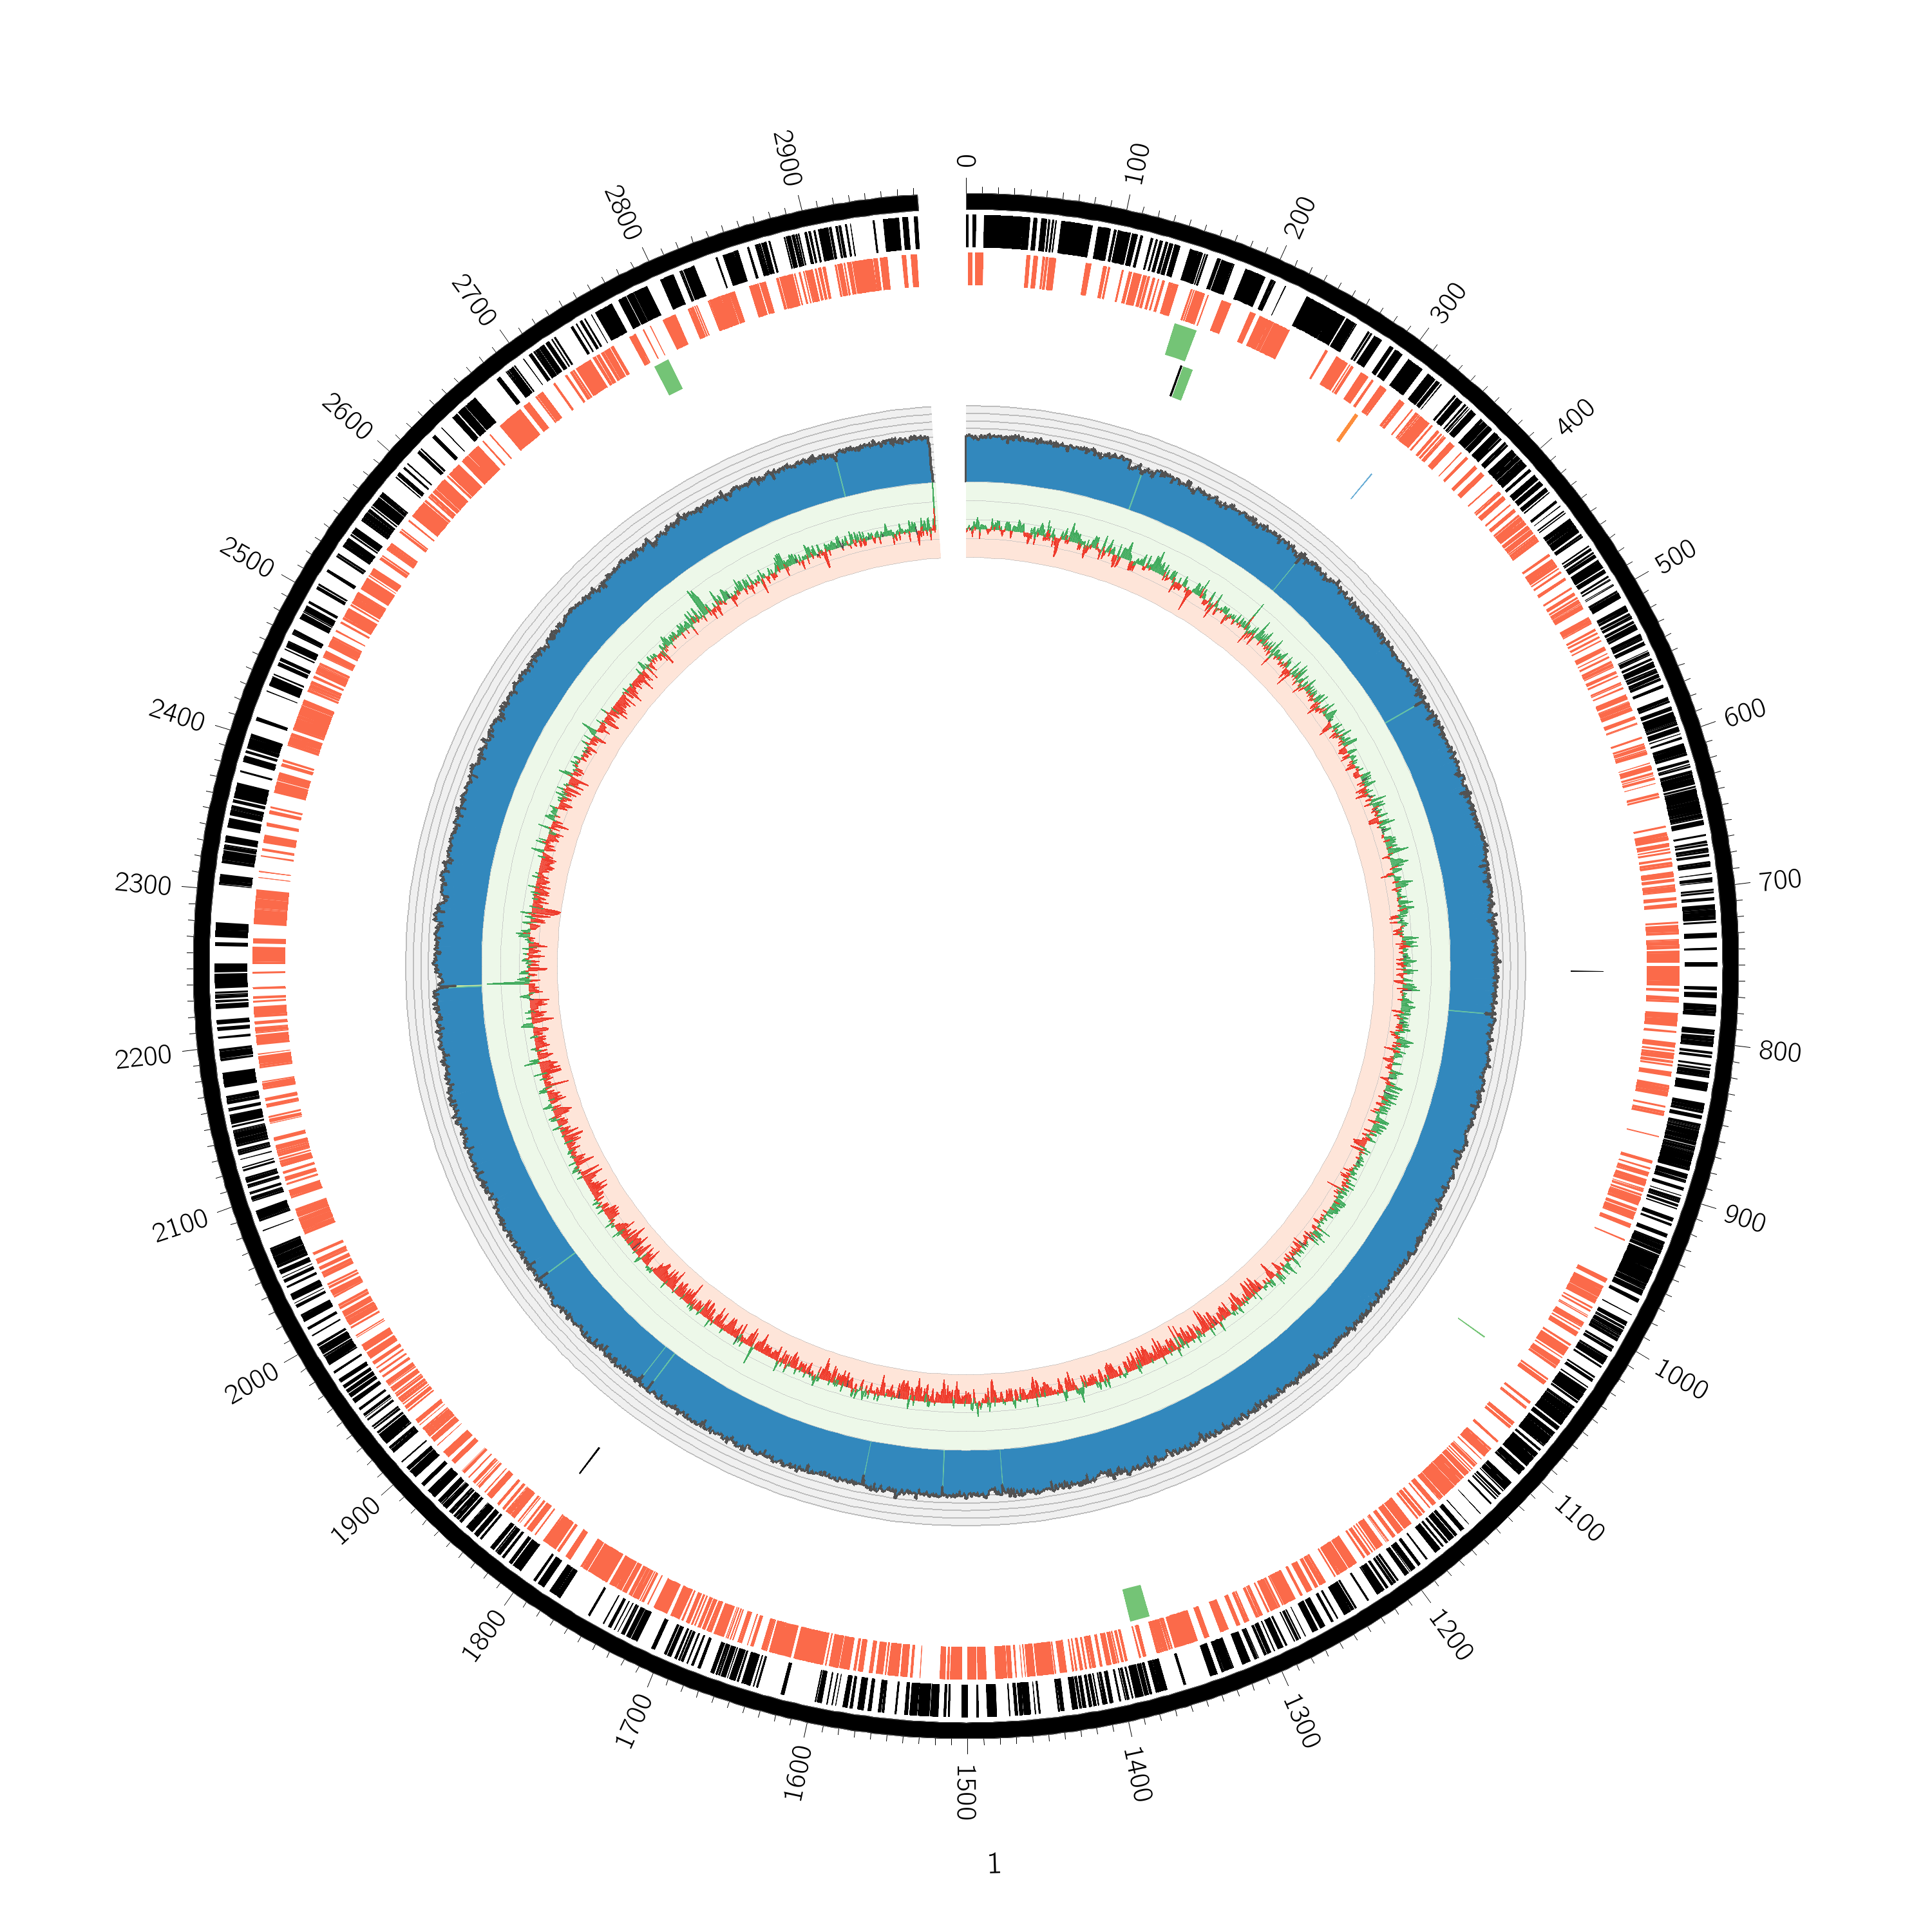
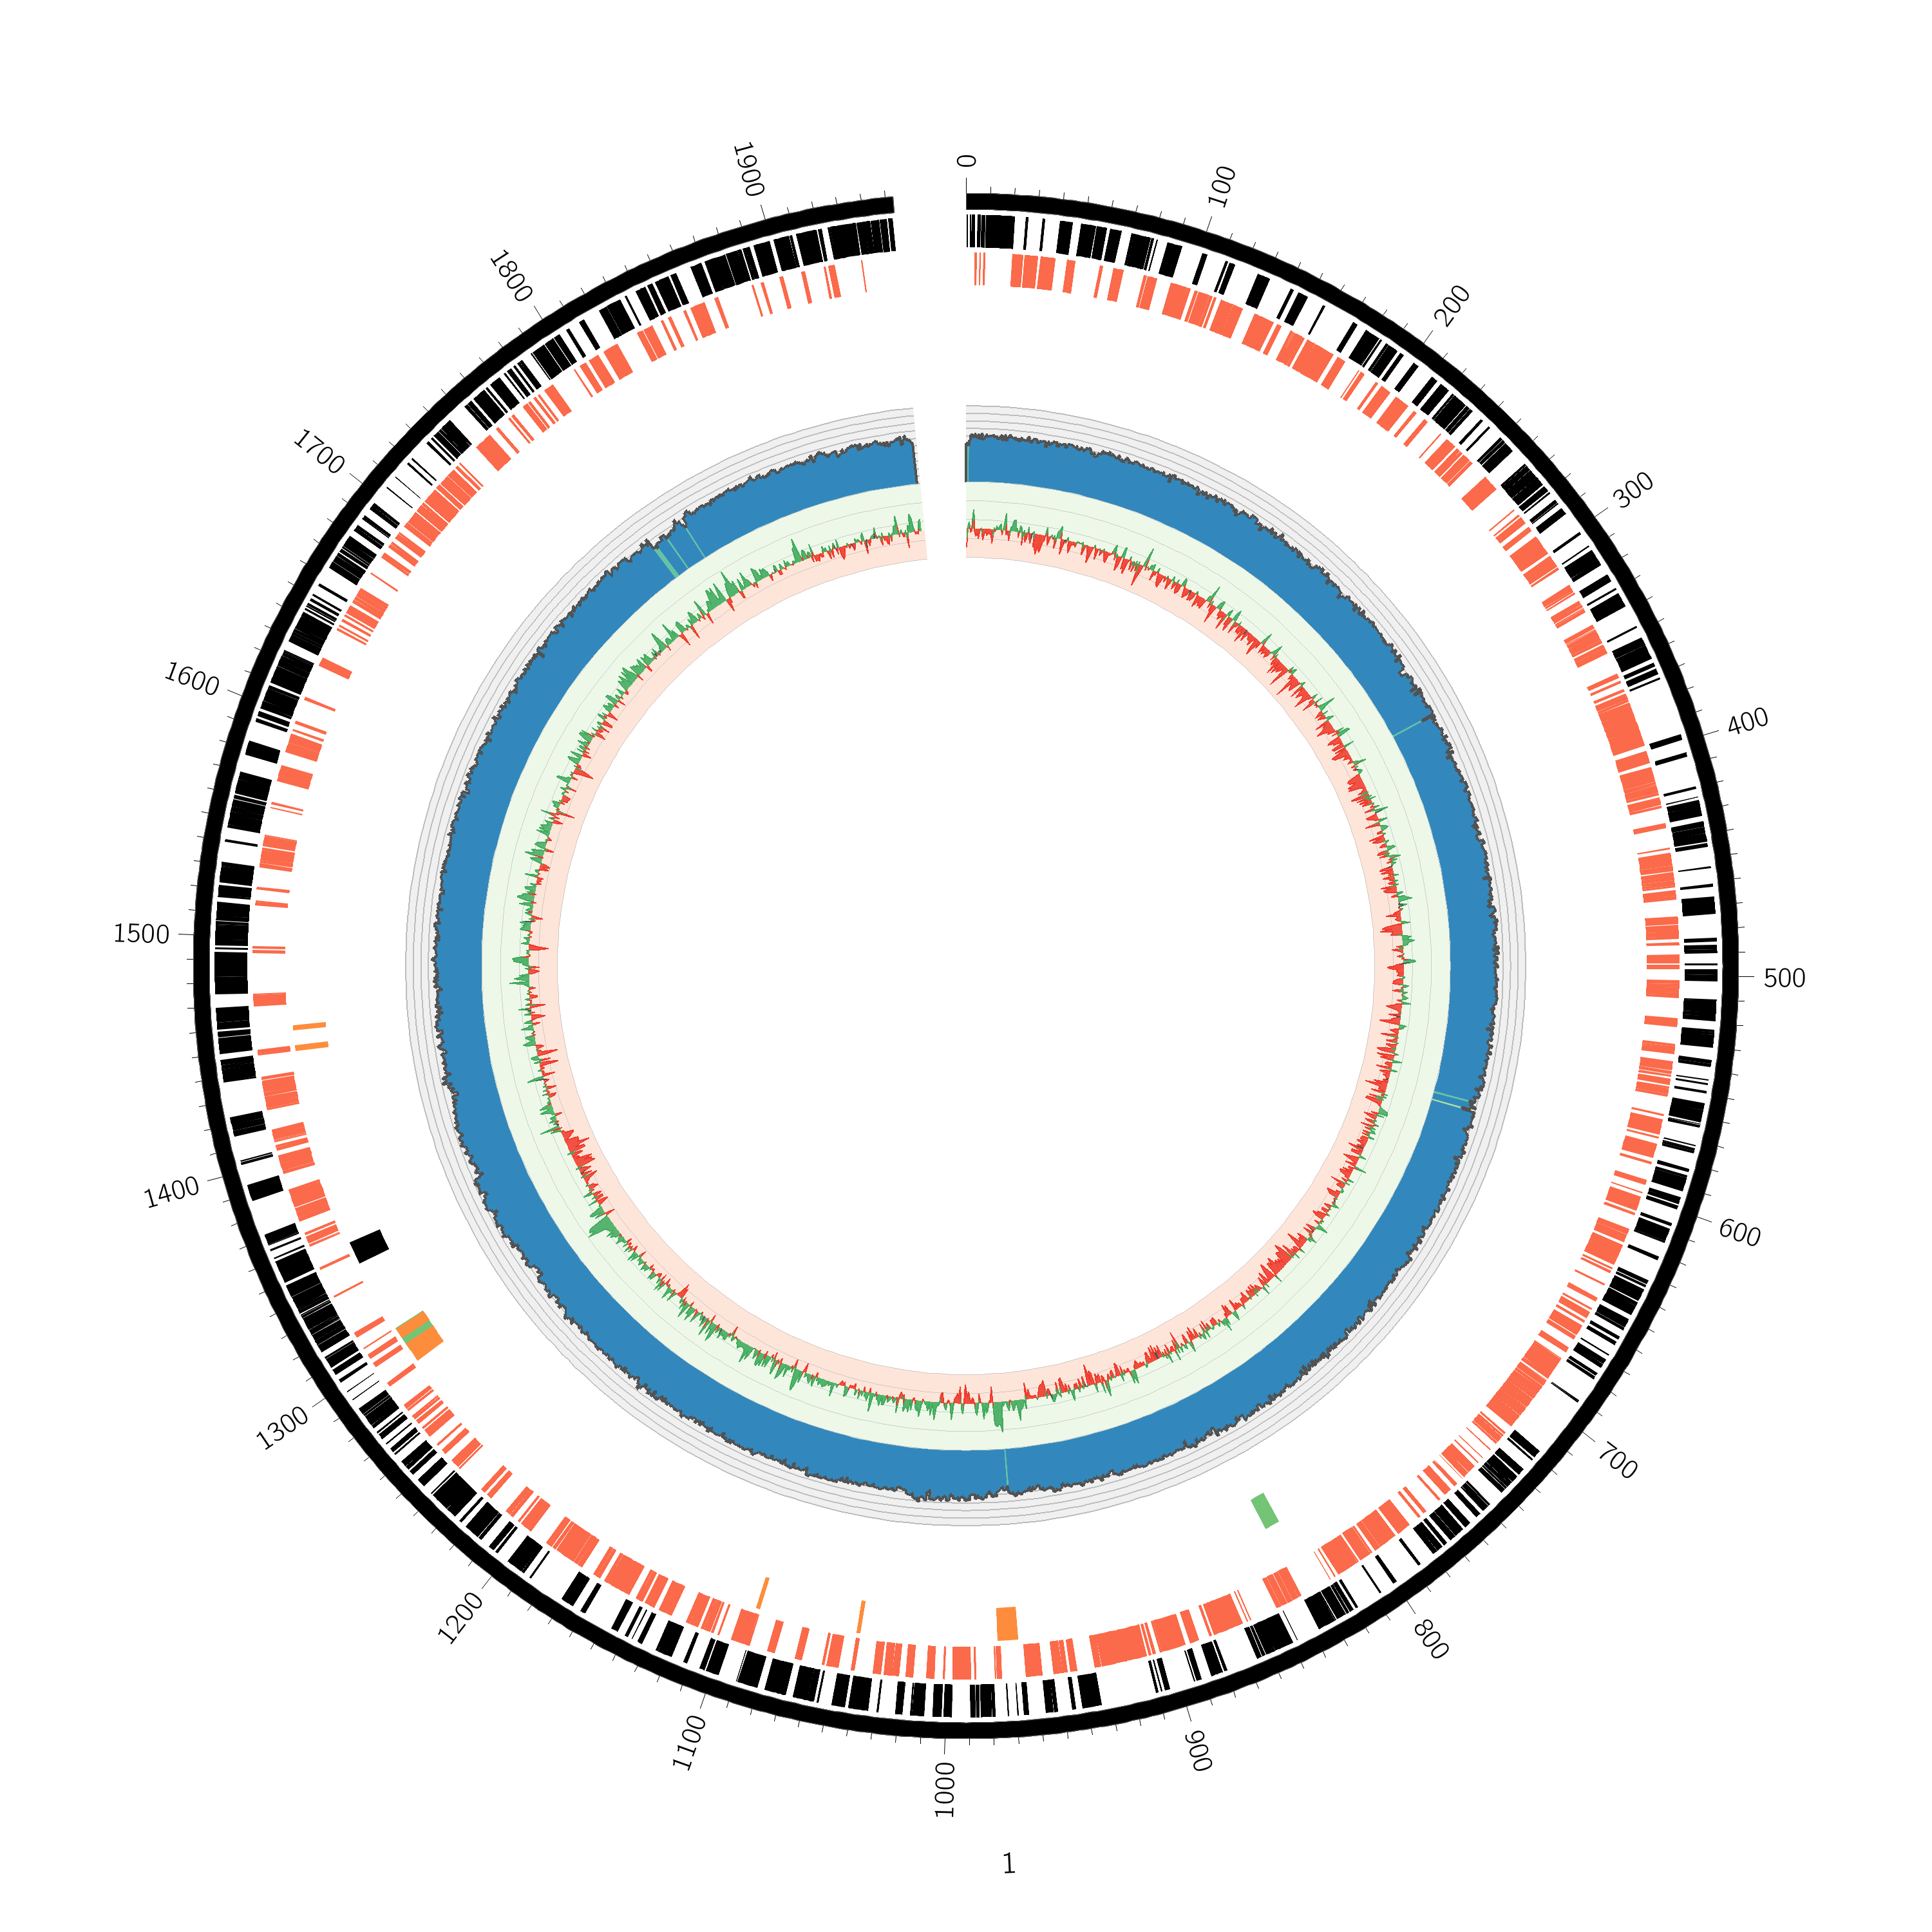
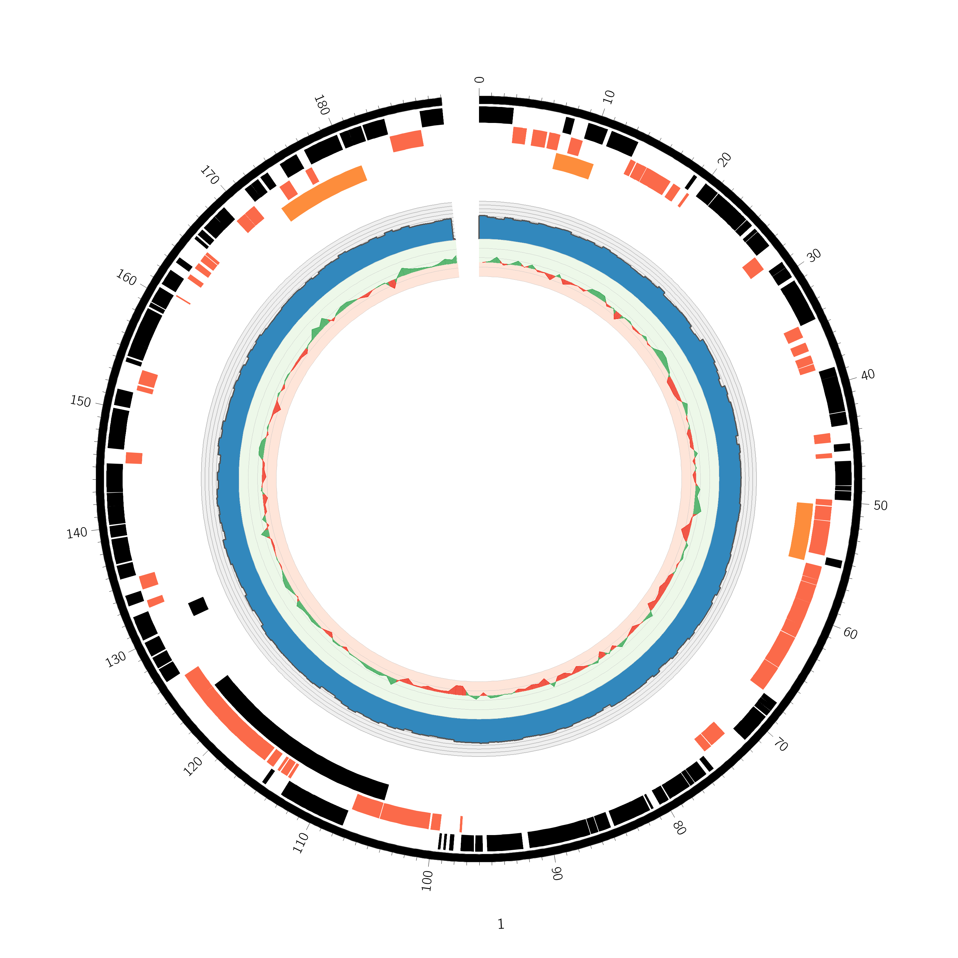
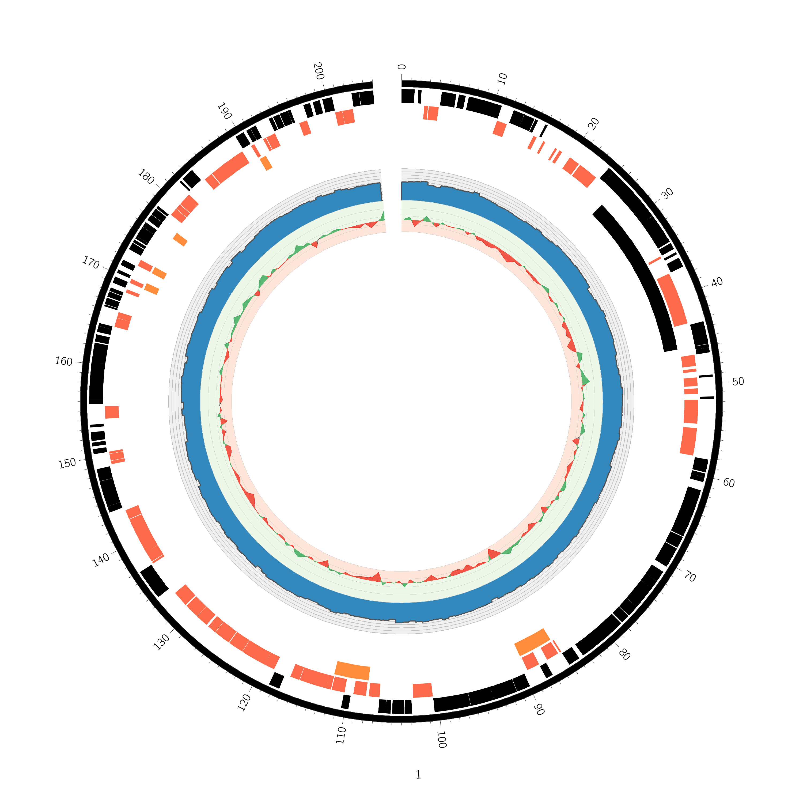
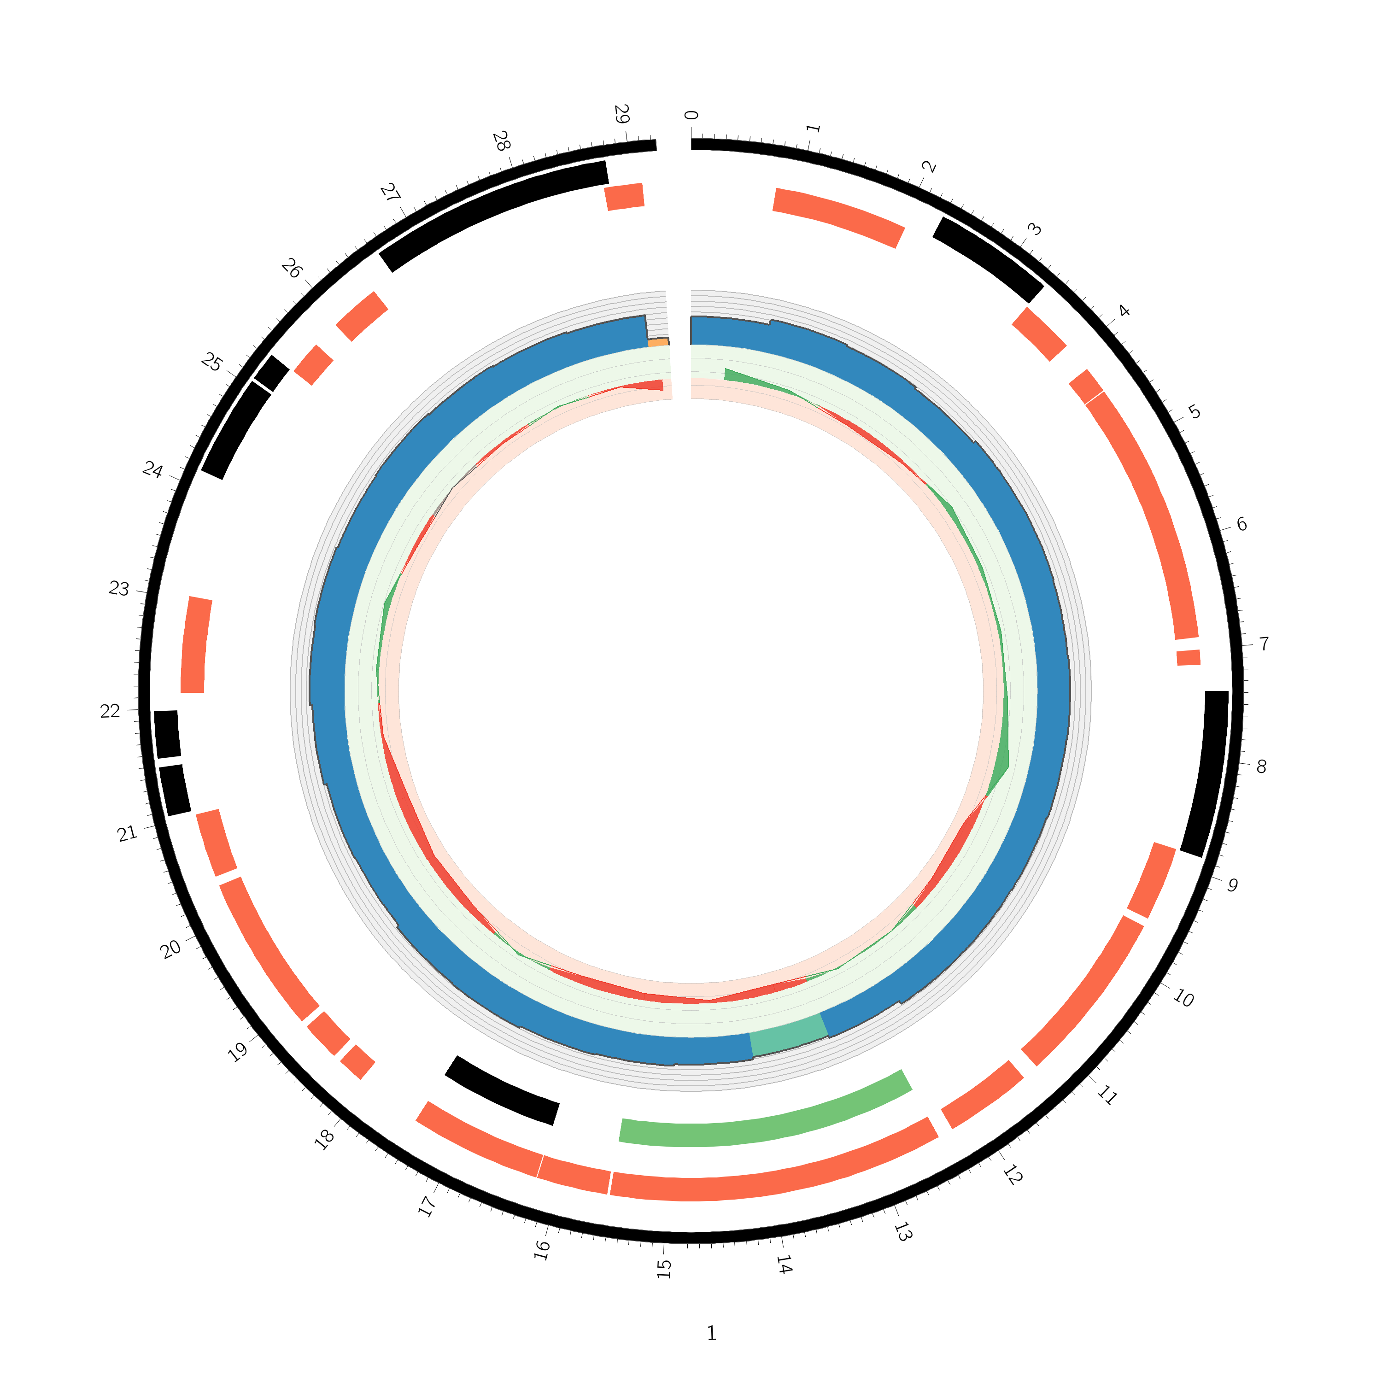
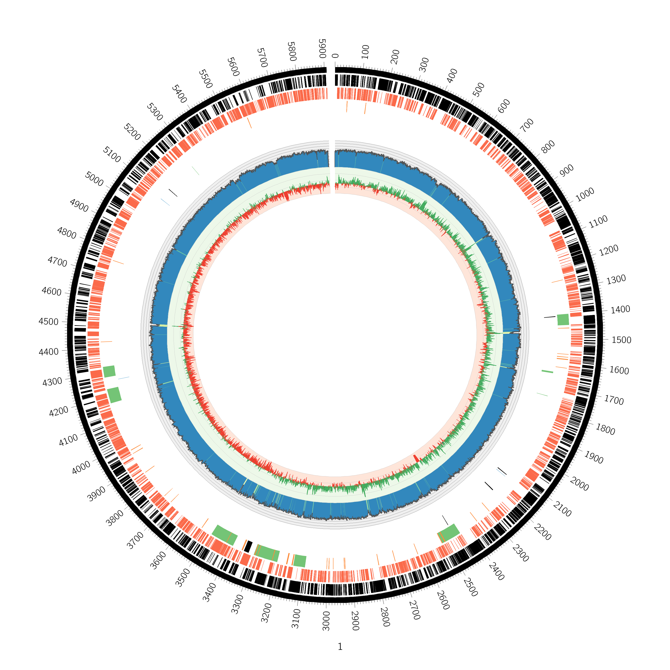
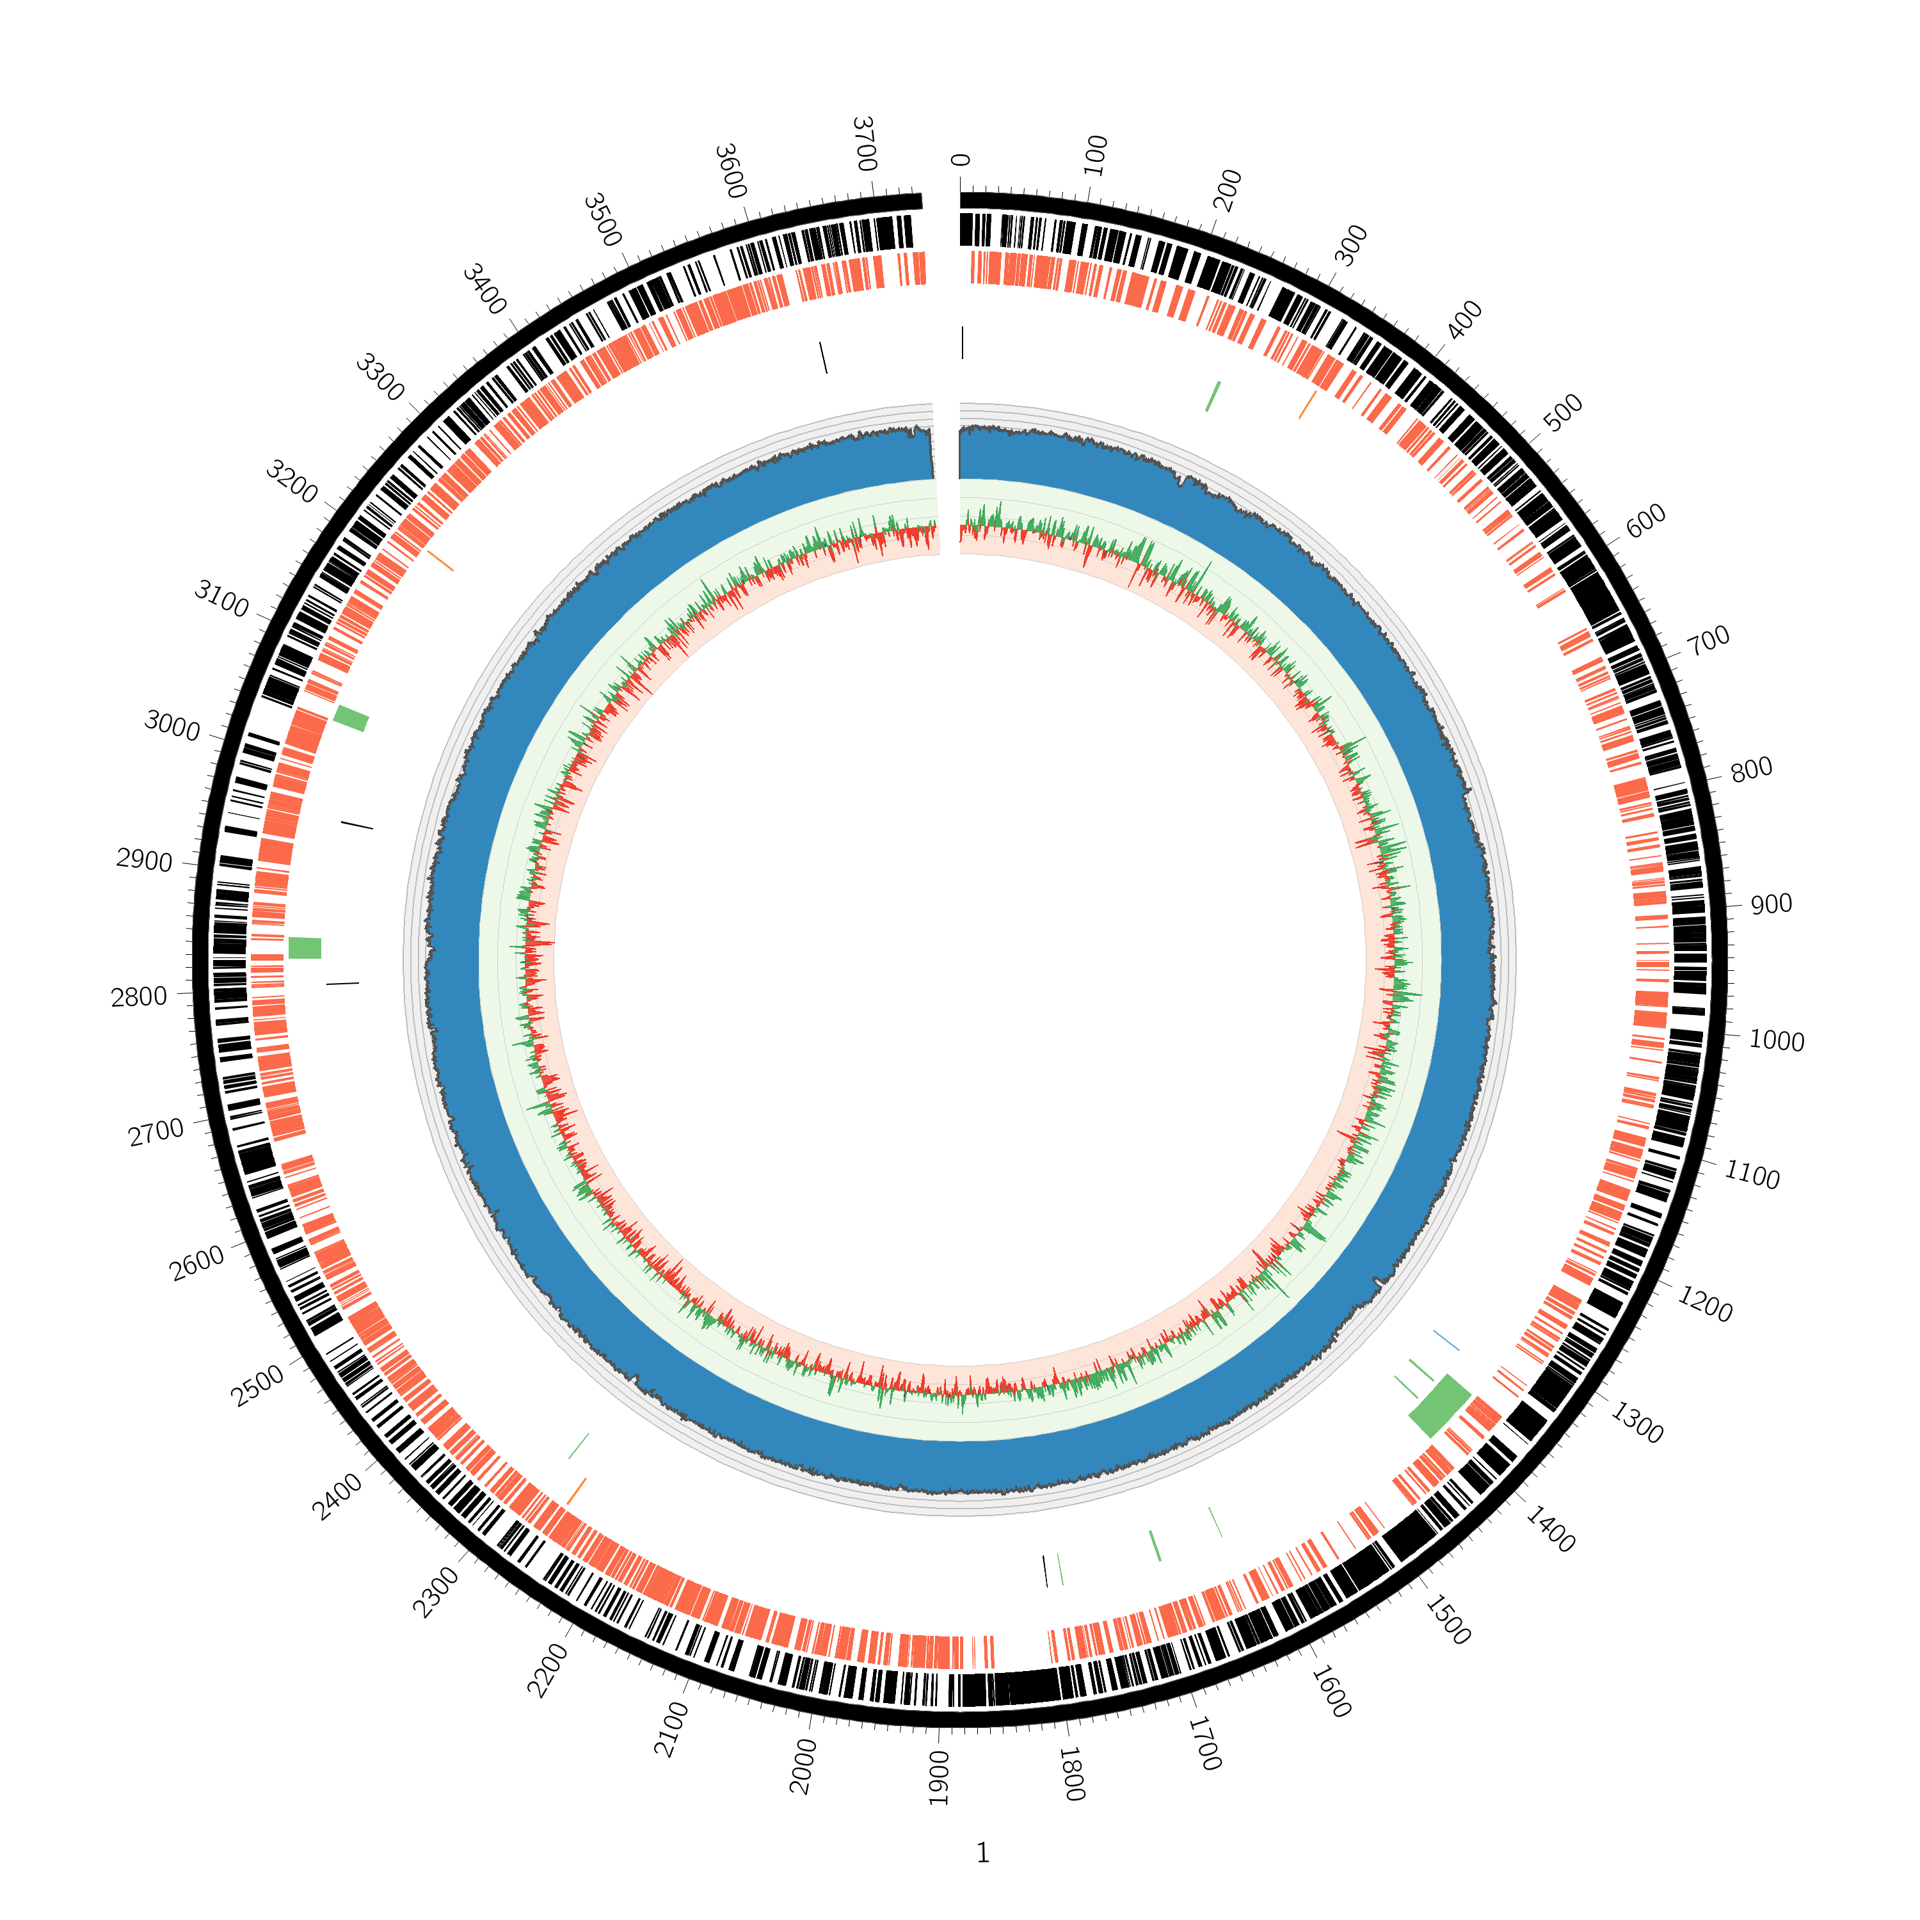
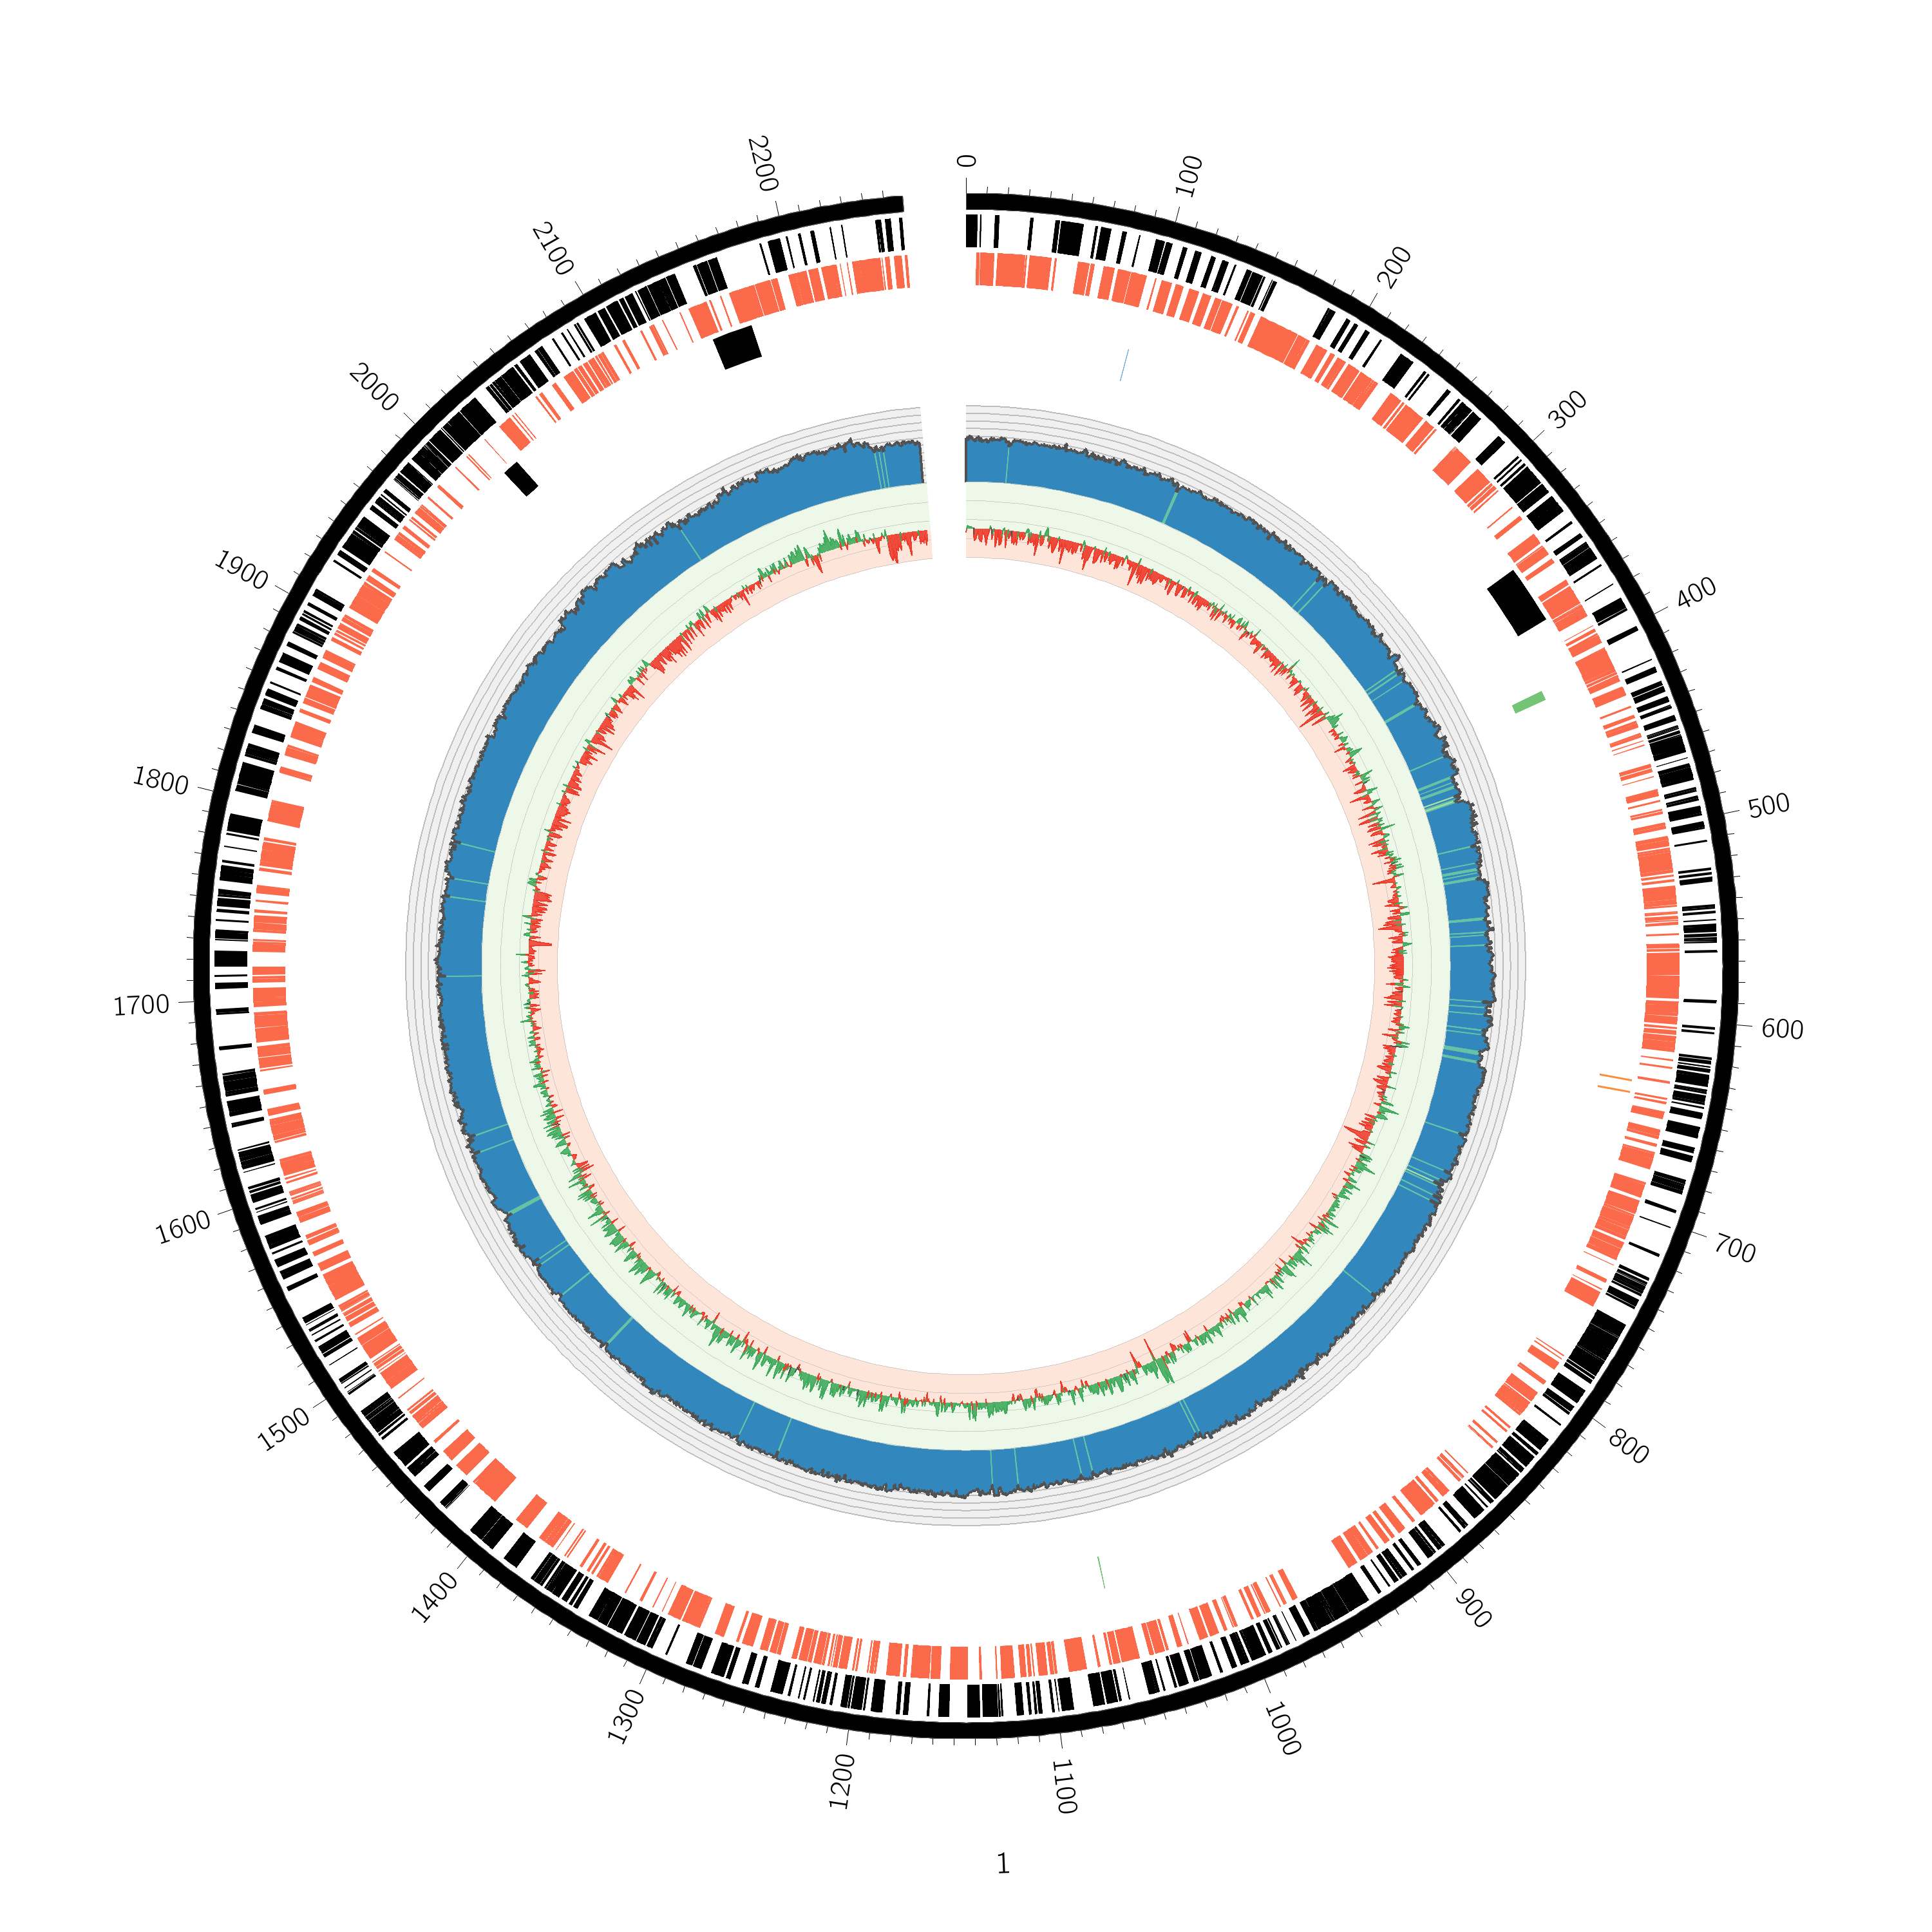
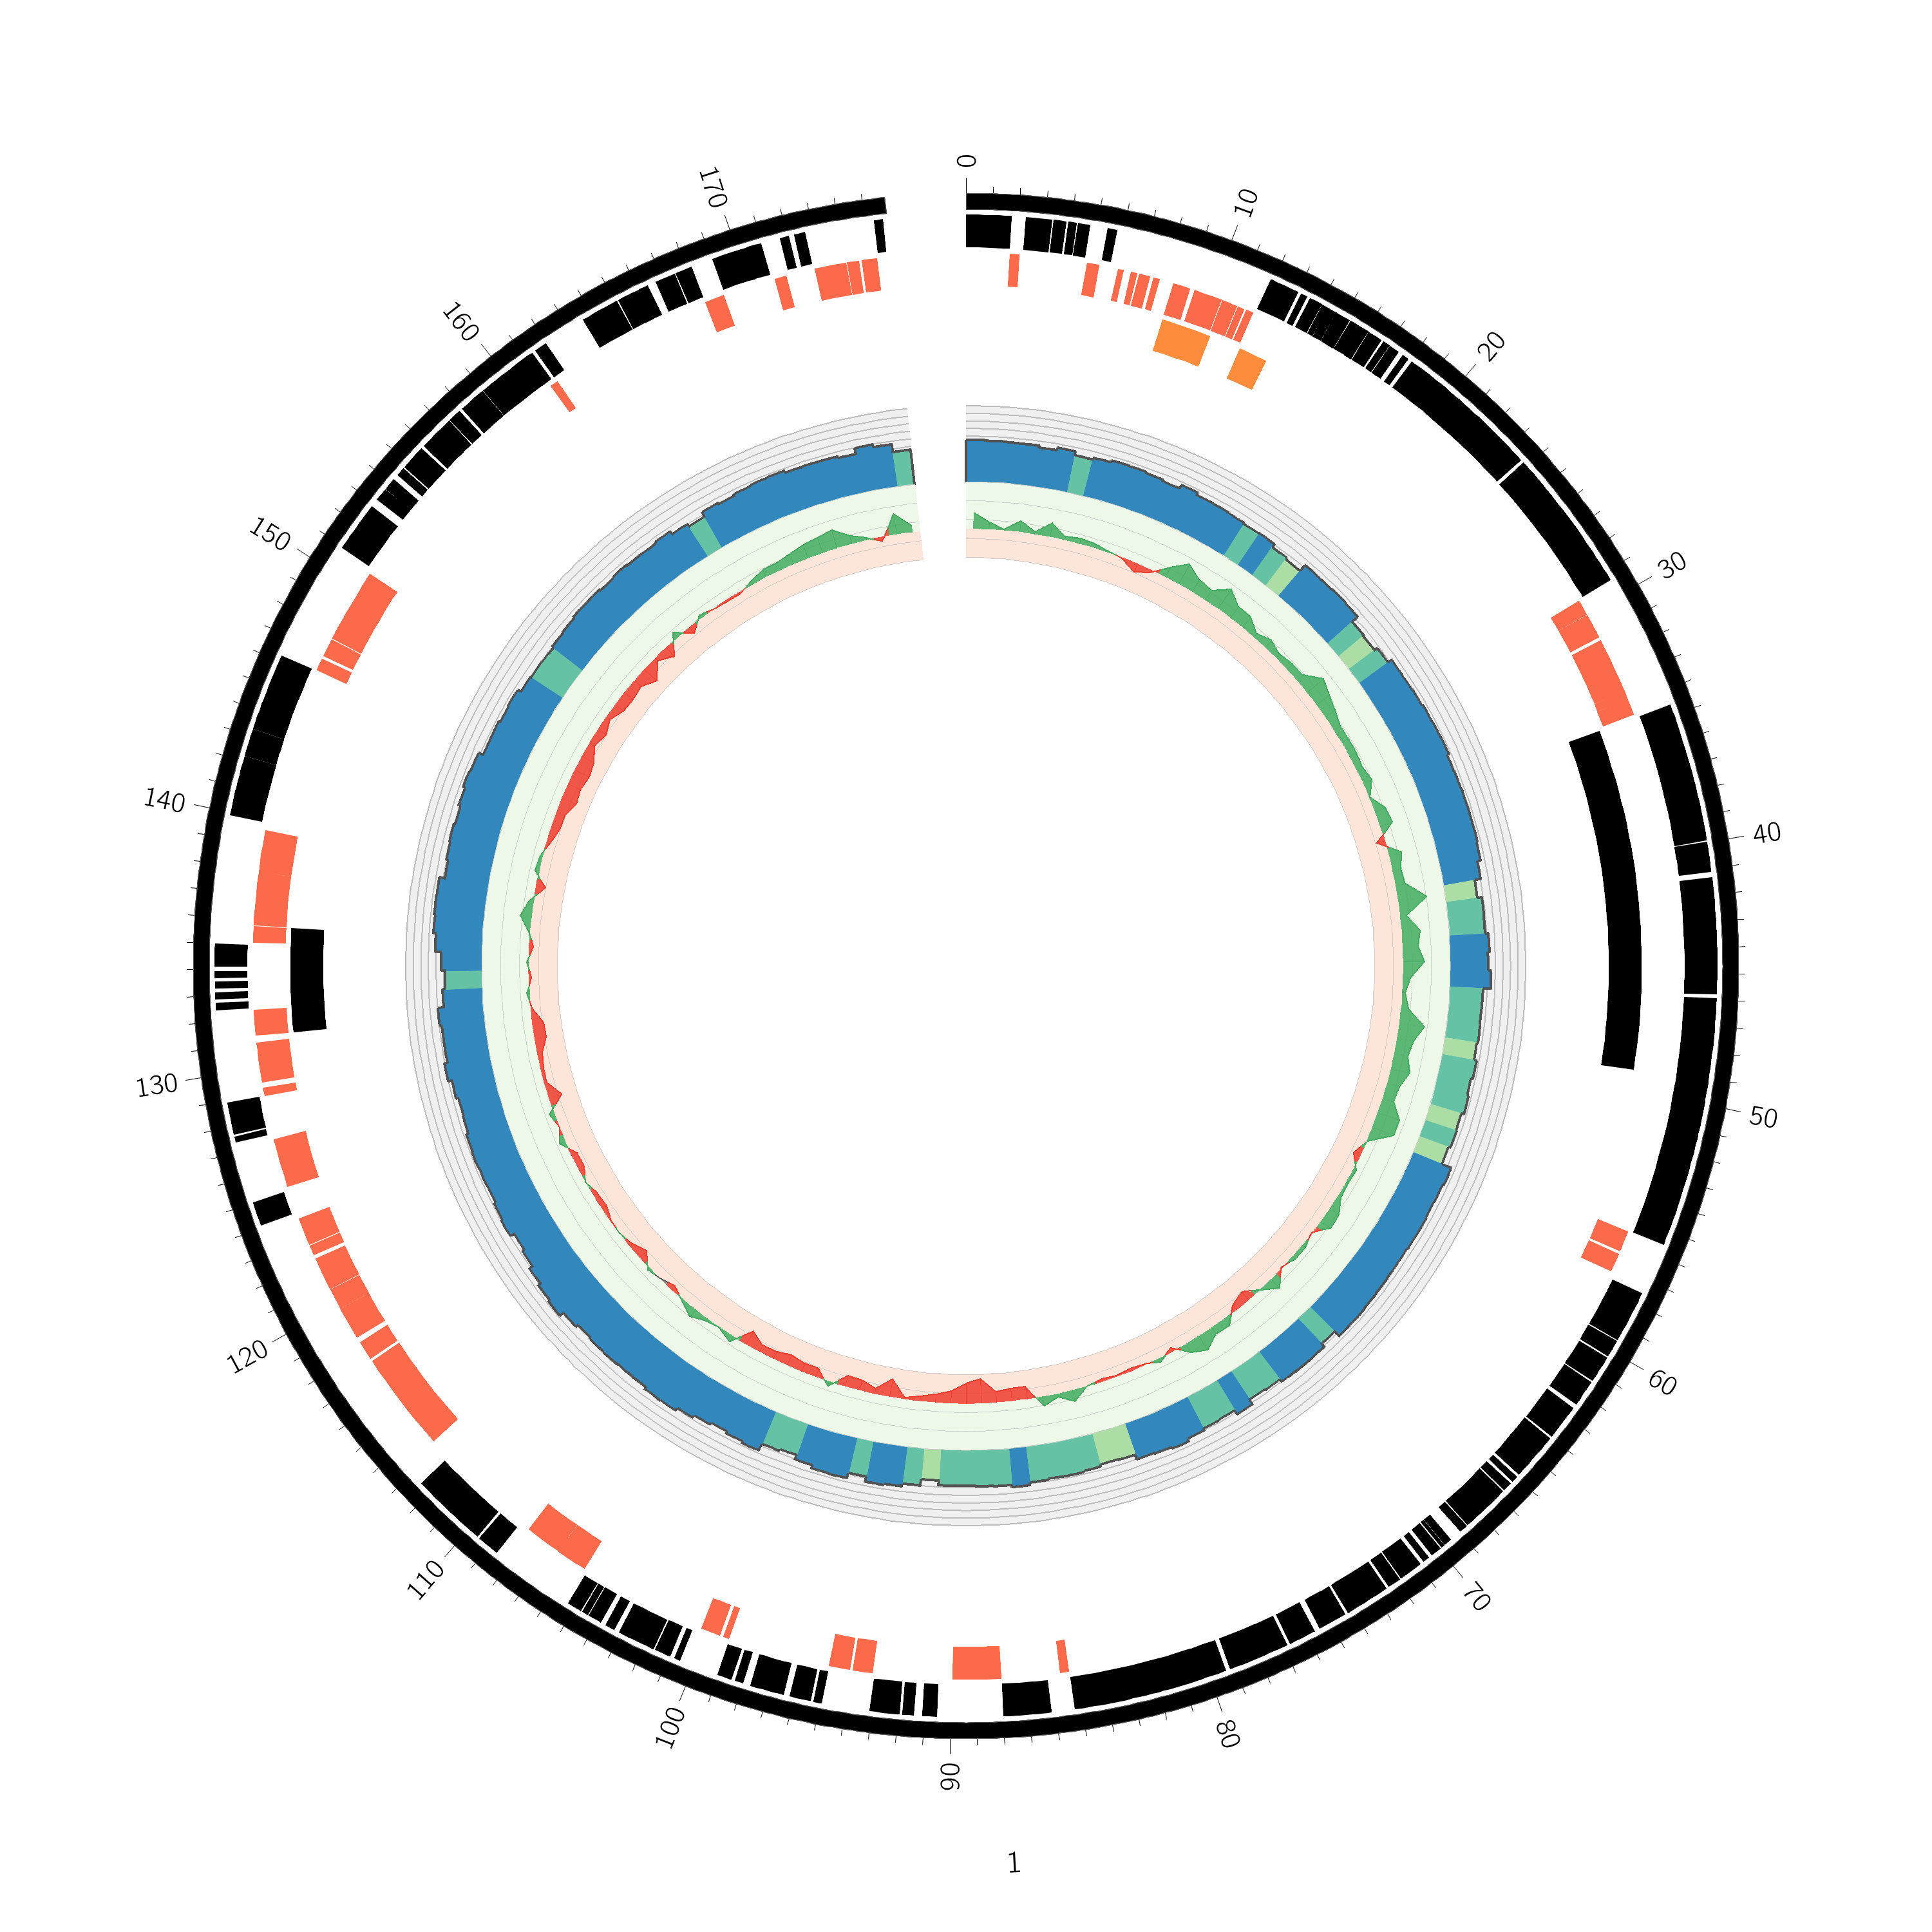
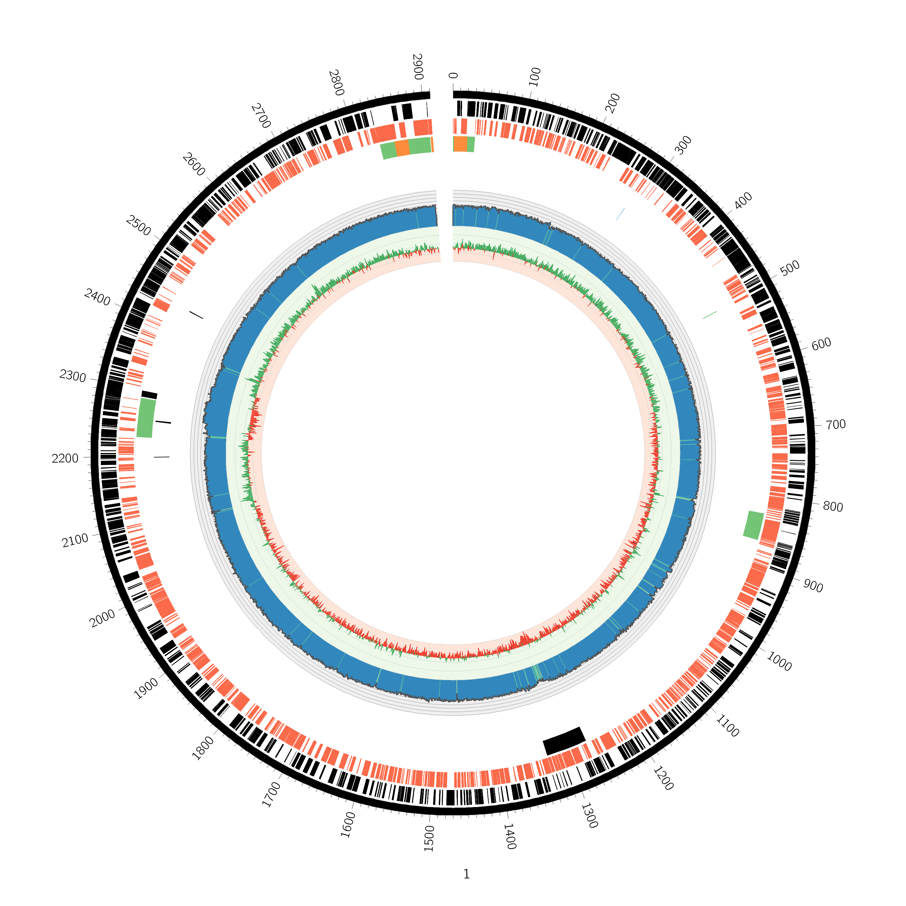
Genomic characterization of four species
Agrobacterium tumefaciens
Linear chromosome
Comamonas testosteroni
Microbacterium saperdae
Ochrobactrum anthropi

Slide 5
How will their interactions evolve?
In mono-culture (At, Ct)
In co-culture (3-species and 4-species together)
44 weeks corresponds
to ~600 generations
t=0
t=1
t=44
measure
CFU/ml
measure
CFU/ml
measure
CFU/ml
measure
CFU/ml
5 replicates
Notes:
Grow all as monoculture and make experiment with 2 monocultures (At & Ct) and 2 co-culture (3 species: At, Ct, Ms; 4 species: At, Ct, Ms, Oa)
Transfer every week 1% of mixture to new bottle and measure CFU/ml
(MWF – Metal working fluid – Bacteria are used to detoxify this fluid -> applied side of the study)
Make transfer for 44 weeks each microcosmos with 5 replica.

Slide 6
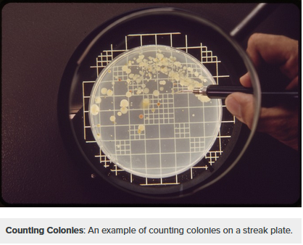
Colony Forming Units (CFU)
Assumption: Each cell gives rise to a colony (white spots)
Count the colonies + based on the known volume of the culture
→ CFU/ml : a proxy for population size (N) per ml
https://courses.lumenlearning.com/boundless-microbiology/chapter/counting-bacteria/

Slide 7
What we have (evolved metagenomes)
At alone: 2 populations (3 went extinct)
Ct alone: 5 populations
At + Ct + Ms: 5 populations
At + Ct + Ms + Oa: 5 populations (in 2 Ms went extinct)
Sequenced with Illumina (for point mutations), 150 PE
4 timepoints (Transfers 11, 22, 33, 44)
Total: 68 samples
Notes:
Sequencing only done on samples at week 11, 22, 33, 44

Slide 8
Population size (CFU/ml) per “microcosm” per microbe
Only 2 replicates
survived for At
Monocultures
Initial strong bottleneck
followed by recovery

Slide 9
Population size (CFU/ml) per “microcosm” per microbe
Monocultures
Co-cultures
Ms went extinct in 2 out of 5 replicates

Slide 10
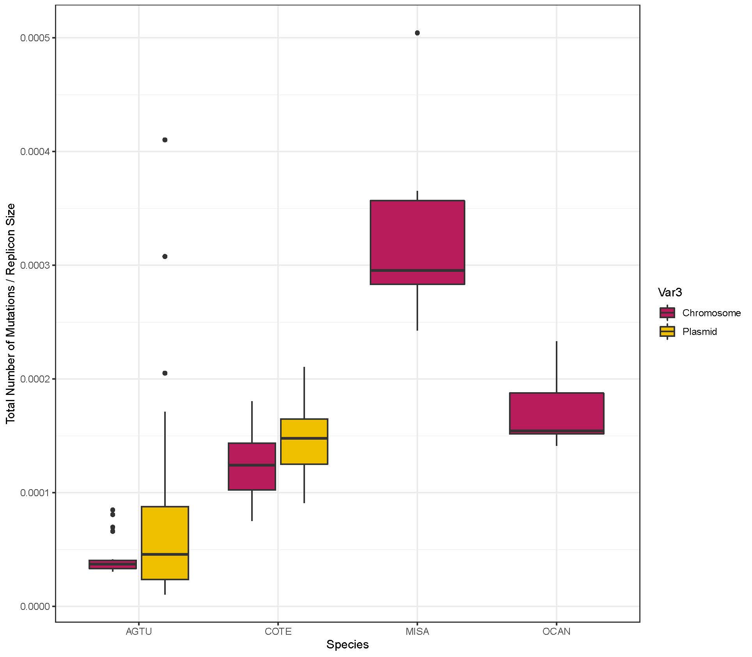
SNPs per specie and per type (chromosome or plasmid)
****
No sign. difference between chr and plasmid
MISA +++ SNPs than the other 3 species
AGTU --- SNPs than the other 3 species
****

Slide 11
SNPs per specie and per type (chromosome or plasmid)
****
No sign. difference between chr and plasmid
MISA +++ SNPs than the other 3 species
AGTU --- SNPs than the other 3 species
→ Number of SNPs increases with CFU/ml decreasing
****

Slide 12
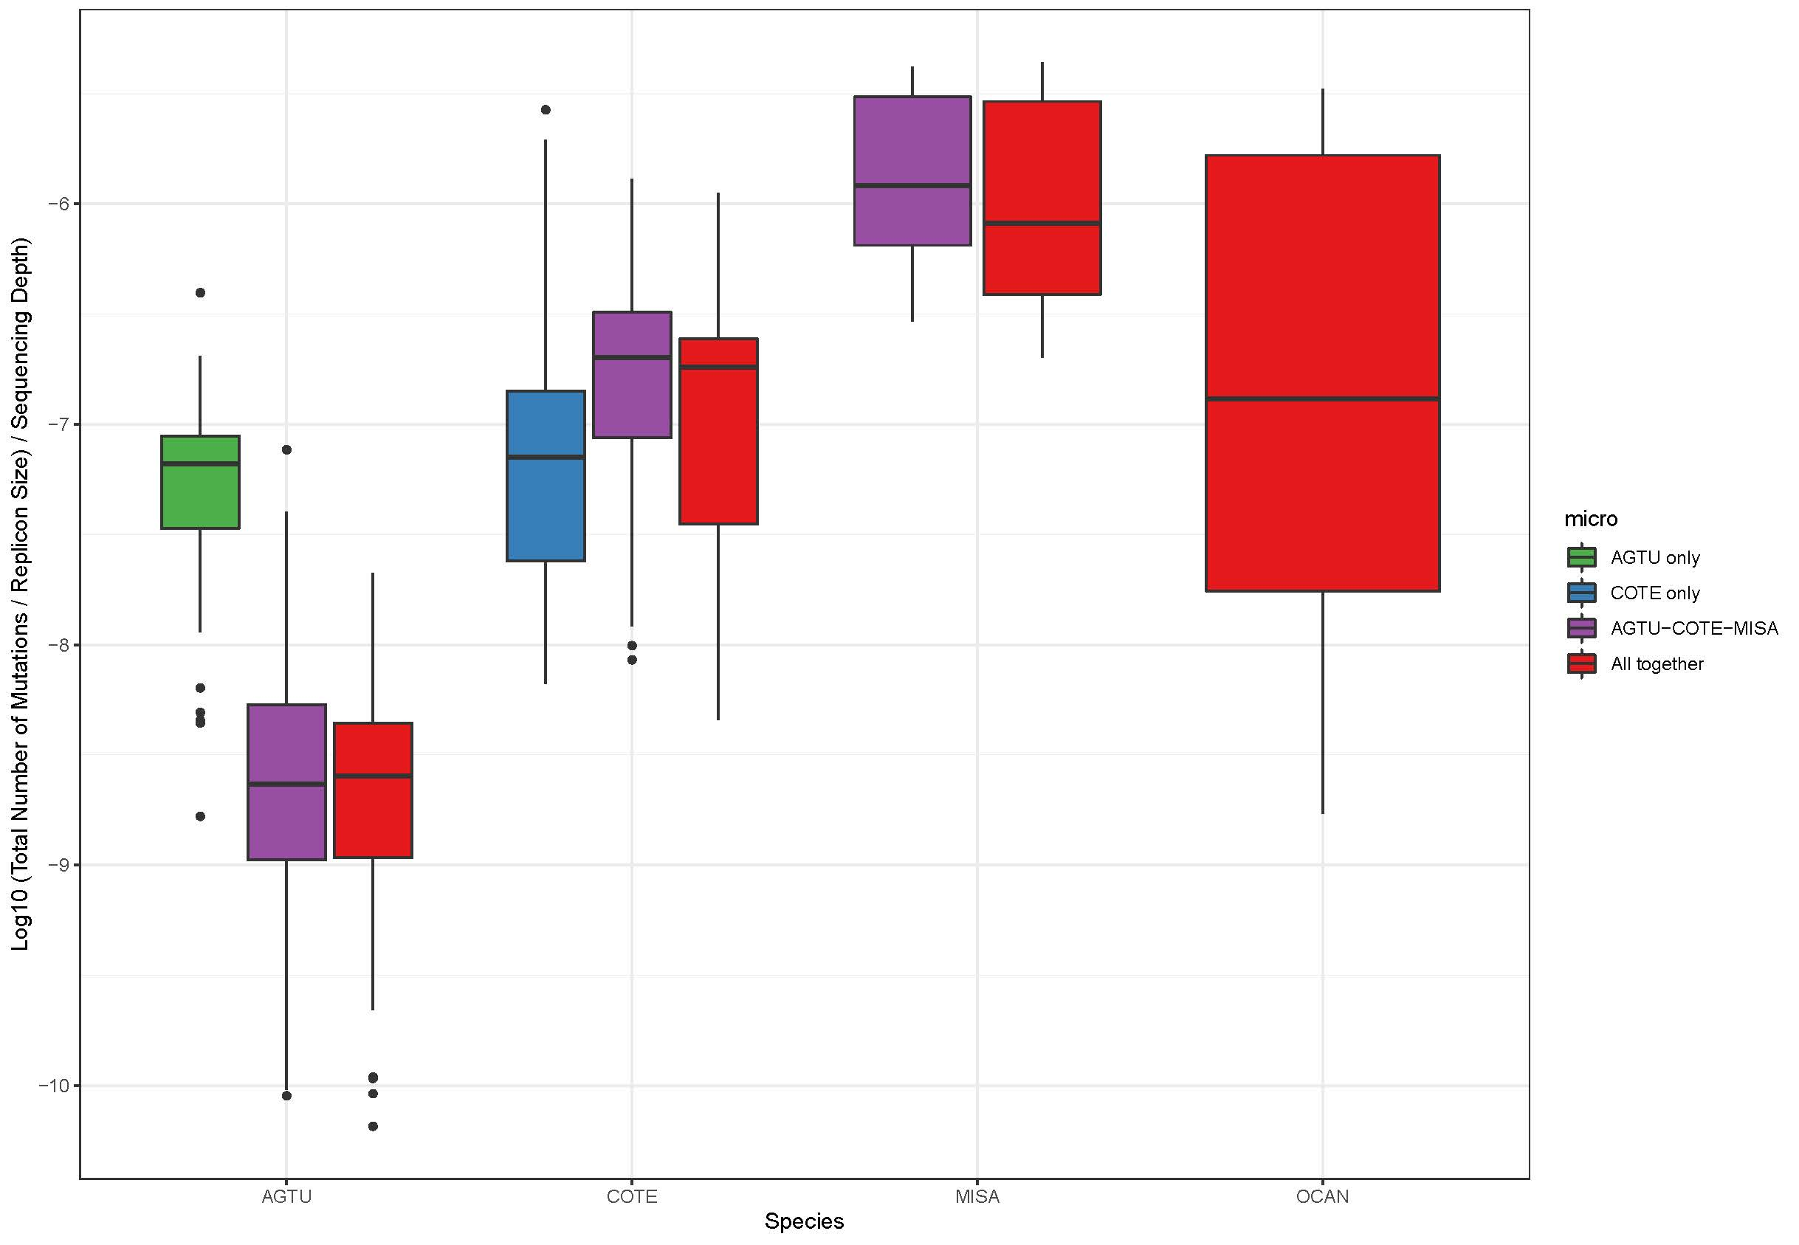
SNPs per specie and per microcosm
****
AGTU: Sign. higher number of SNPs when alone than with other microbes

Slide 13
SNPs per specie and per microcosm
****
AGTU: Sign. higher number of SNPs when alone than with other microbes
Relaxed selection (mutation accumulation) due to drift ?
When co-cultured, more stable, benefit from the others ?

Slide 14
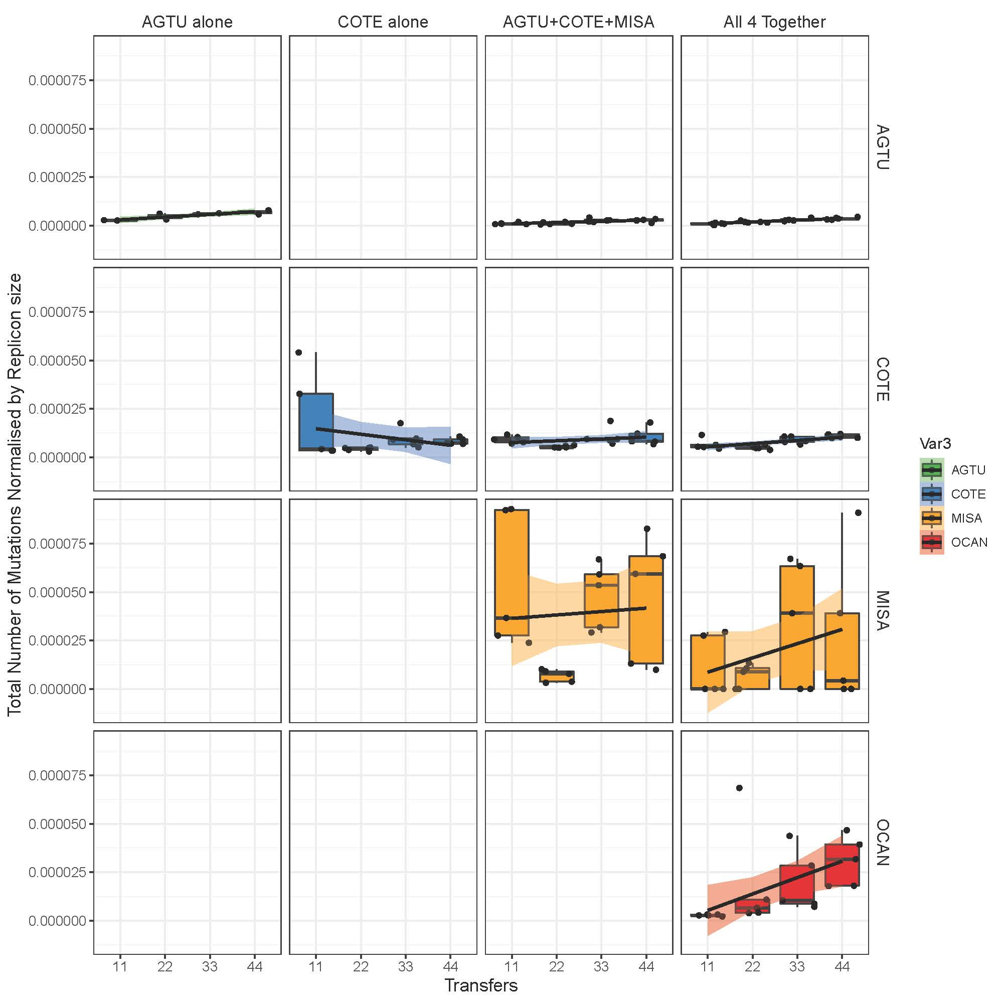
SNPs per specie and per microcosm across time
Rho = 0.9
****
Rho = 0.6
*
Rho = 0.8
****

Slide 15
SNPs per specie and per microcosm across time
Rho = 0.9
****
Rho = 0.6
*
Number of SNPs increases with CFU/ml decreasing.
For MISA, due to the extinction of 2, correlation cannot be done globally → need to see how every replicate behaves (next slide)
Rho = 0.8
****

Slide 16
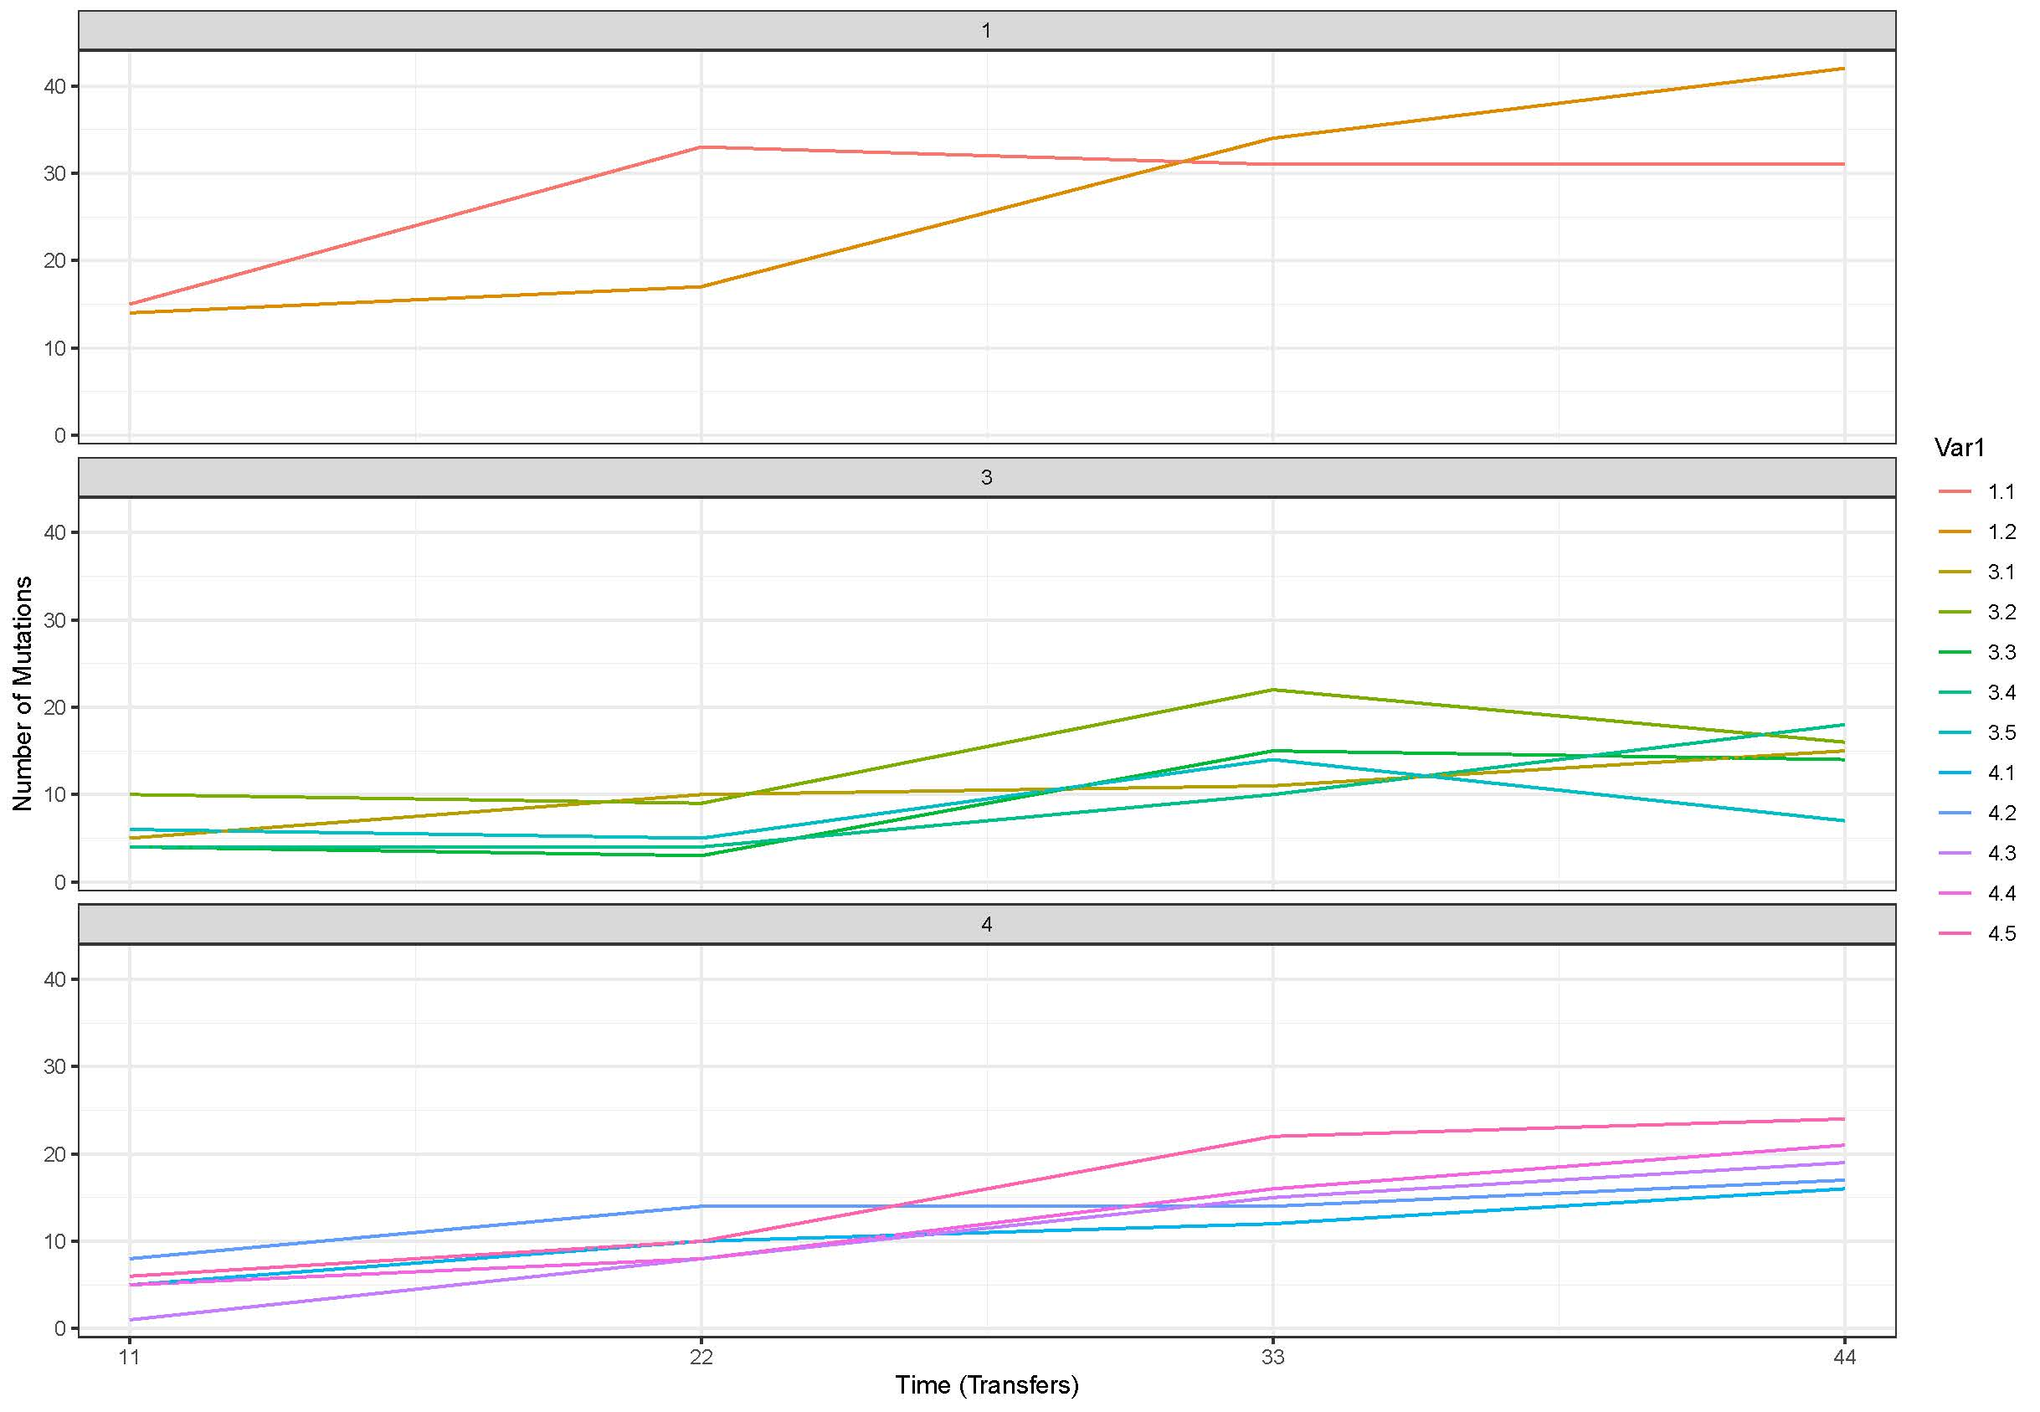
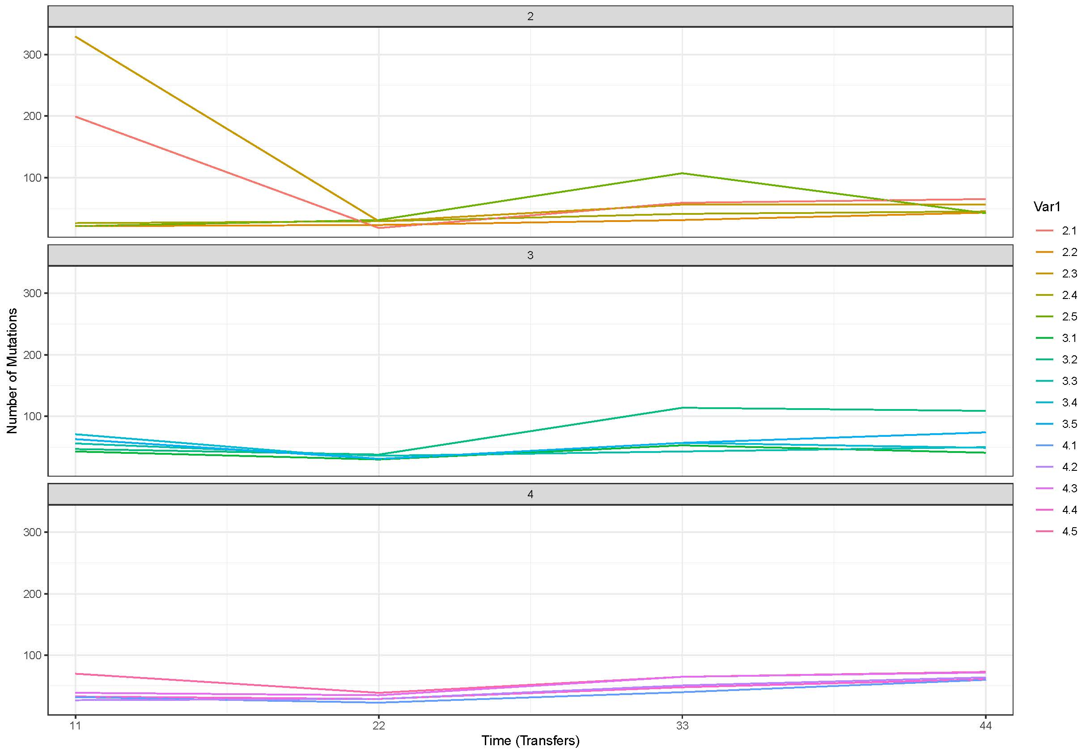
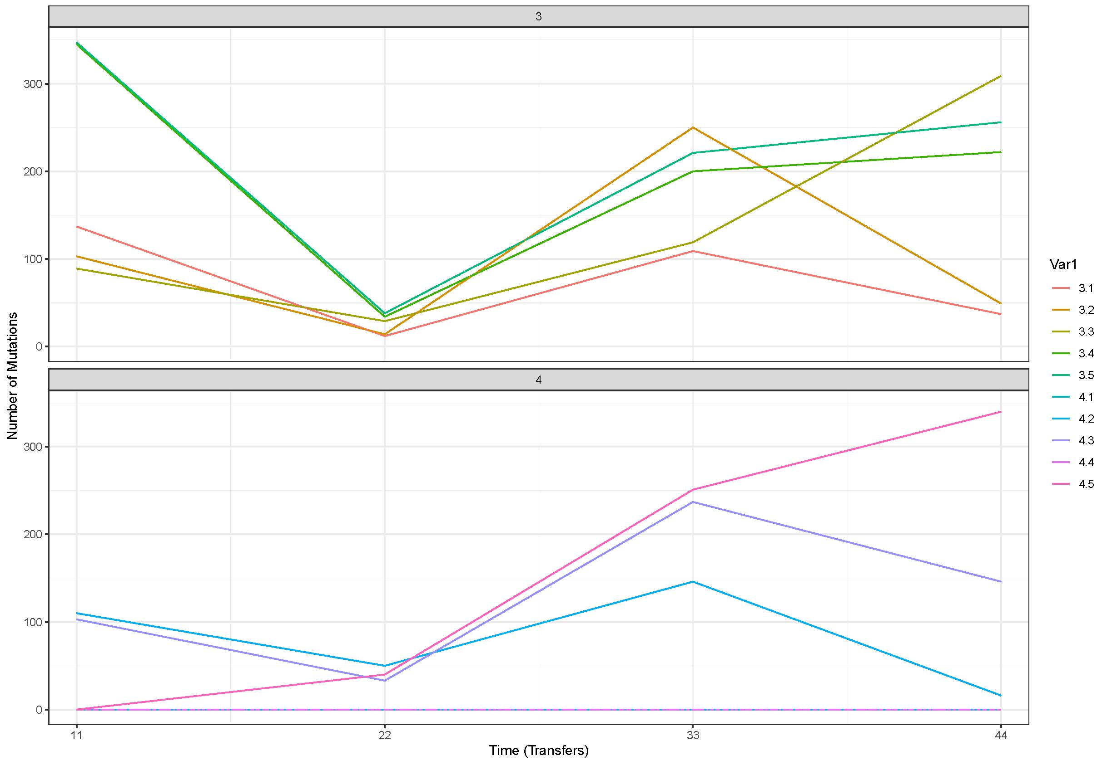
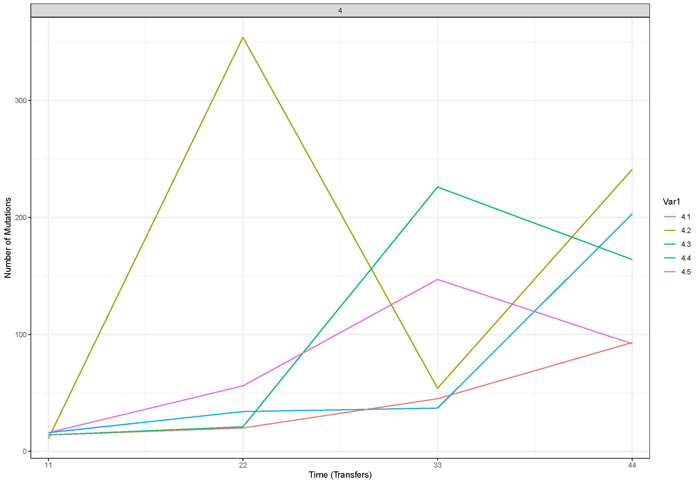
COTE
AGTU
Total number of SNPs per transfer, per replicate and per microcosm
Not all replicates have similar pattern
OCAN
MISA

Slide 17
For COTE and AGTU, in the 4th microcosm (all 4 together), the total number of SNPs increases
with time and number of transfers, for all 5 replicates
COTE
Rho = 0.6
*
AGTU
Rho = 0.9
****

Slide 18
OCAN in the 4th microcosm (all 4 together)
Mutants arise but are then selected against,
leading to a reduction in mutations ? Equilibrium not reached yet ?

Slide 19
Some of Sara’s questions (that are relatively easy to answer)
What are genes with fixed mutations and do they tell us what the species might have adapted towards? Environment or each other?
→ Functional data (SNPs inside which genes ? Their function ?)
Do we see the same mutations in replicates of the mono-cultures or in co-culture?
→ Compare the SNPs between replicates
Can we estimate dN/dS? Which genes are under positive/purifying selection?
→ List of nonsynonymous vs synonymous SNPs
Have mutations in ”social” traits (e.g. biofilm, quorum-sensing, siderophores, antibiotic-degrading enzymes) occurred more in co-evolution treatment?
→ Functional data (SNPs inside which genes ? Their function ?)

Slide 20
Some of Sara’s questions (that are quite difficult to answer)
Is there a difference between mono- and co-evolved?
→ Possibly. How can we answer this ? Number of SNPs ? Which genes ? … ?
Can we estimate mutation rate?
→ Difficult not many data points.
Perhaps make Mueller plots?
→ We need haplotype information for this ?
Can we map out the fitness landscape using the four-species community evolution and predict the three-species one?
→ ??????

Slide 21
Other questions ?

